Slide 1
IMDb Movie Analysis
IMDb
By Gayatri Palkar

Slide 2
Contents
The Problem Statement
Data Preprocessing
The Five Why’s Approach
Data Analytics Tasks
Project Report
Video Presentation Link

Slide 3
The Problem Statement
The impact of this problem is significant for movie producers, directors, and investors who want to understand what makes a movie successful to make informed decisions in their future projects.
Let us understand the data and the question.
And the Question is…

Slide 4
"What factors influence the success of a movie on IMDB?"
Let us start the analysis to find the solution to this…

Slide 5
Data Preprocessing

Slide 6
Data Preprocessing
Data Preprocessing includes preparing the data for analysis and deriving insights. Its steps include:
Handling Missing Values in Data
Removing Duplicate values
Deciding which columns to keep
Converting values to correct data type
Visualizing the data

Slide 7
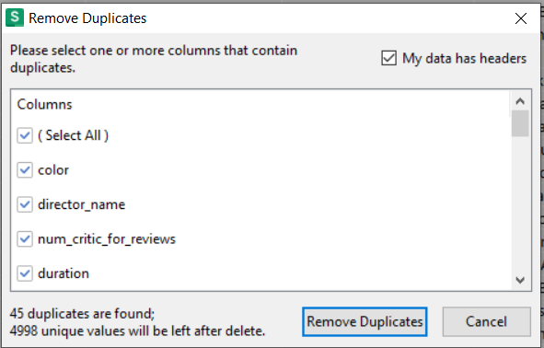
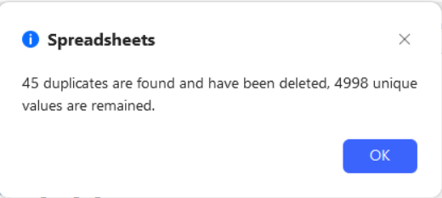
Removing Duplicates
I wanted to remove duplicates before proceeding with Missing data
I selected the data using Ctrl+A, Went to Data Tab and then clicked on Handle Duplicate Data Button -> Remove Duplicates
I found 45 Duplicate values for all rows, I decided to remove them as they will skew the analysis ahead.

Slide 8
2. Decide Columns that are useful in Analysis
I will remove unnecessary columns in data before proceeding with Missing data
color: This indicates whether the movie is in color or black-and-white. It is unlikely to significantly impact modern movie ratings.
director_facebook_likes: The number of likes on a director's Facebook page may not directly correlate with the movie's IMDB score.
actor_3_facebook_likes: Similar to the director's Facebook likes, this may not have a direct impact on the movie's rating.
facenumber_in_poster: The number of faces in the movie poster is unlikely to influence the movie's IMDB rating.
plot_keywords: While plot keywords can be used for text analysis, but not relevant here for numerical analysis.
movie_imdb_link: The URL link to the movie's IMDB page is not useful for the analysis.
aspect_ratio: The aspect ratio of the movie might have limited impact on the movie's success or IMDB rating.

Slide 9
Removing columns from Data
director_name
Num_critic_for_reviews
Duration
actor_2_name
actor_1_facebook_likes
gross
genres
actor_1_name
movie_title
Num_voted_users
Cast_total_facebook_likes
actor_3_name
num_user_for_reviews
language
Country
content_rating
budget
title_year
actor_2_facebook_likes
imdb_score
movie_facebook_likes
List of remaining columns in Data using Python

Slide 10
3. Handling Missing Data
From the data that remains I will now Filter it and remove the rows containing Blanks, Hyphens, Nan values etc
For columns such as - director_name, num_critic_for_reviews, duration, gross, genres, actor_1_name, movie_title and language I decided to Remove the blank value rows completely
For column content_rating I decided to rename the Blank columns as “Unrated”
For the column budget, I decided to take the median of the budget column as it won’t be affected by any outliers, but I did not get representative value, so decided to Delete those rows as well

Slide 11
3. Handling Missing Data continued
For columns such as - actor_2_name, actor_1_facebook_likes, actor_2_facebook_likes, movie_facebook_likes - I decided to keep the blanks as it might happen that some movie does not have a second Lead or Actor, also not all actors use facebook
Now the Missing Data Handling is over, and I will start with further analysis

Slide 12
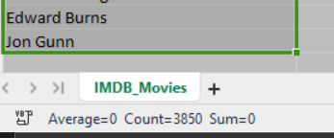

After removing missing values
Data count becomes
3850 rows and 21 columns

Slide 13
4. Converting Data types
Ensuring that the columns like duration, budget, gross, etc., are in numeric format.
Select the column, right-click, and choose Format Cells to set the correct data type.
Converted actor_1_facebook_likes, actor_2_facebook_likes, movie_facebook_likes columns to number with 1000 separator and 0 decimal values and gross and budget columns to currency data type

Slide 14
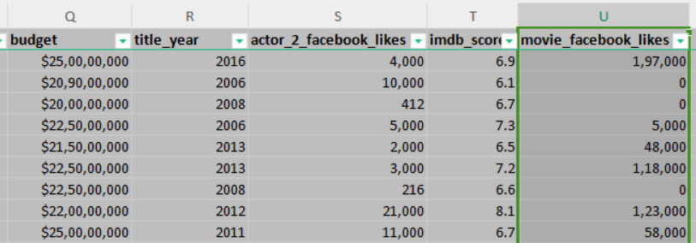
4. Converting Data types continued

Slide 15
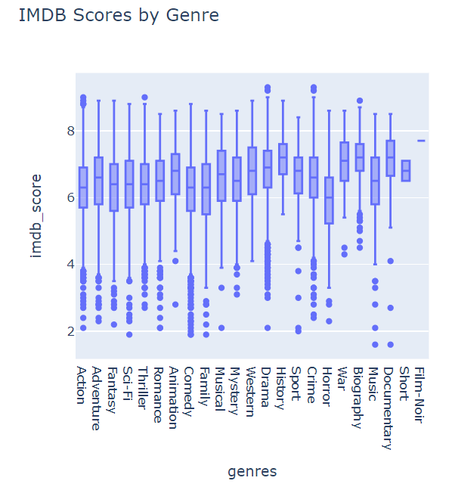
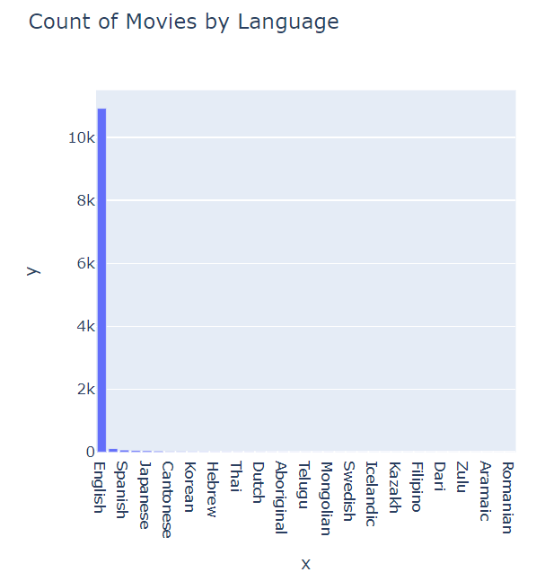
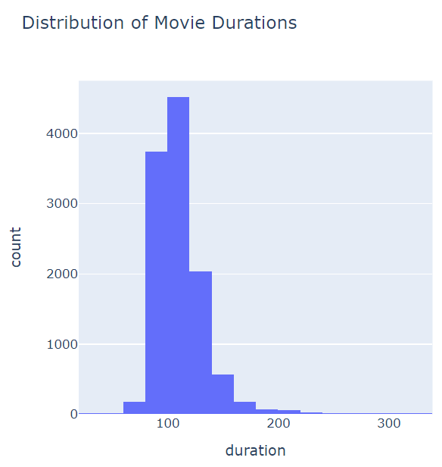
5. Visualize the Data
I have used python programming for EDA on the IMDB data:

Slide 16
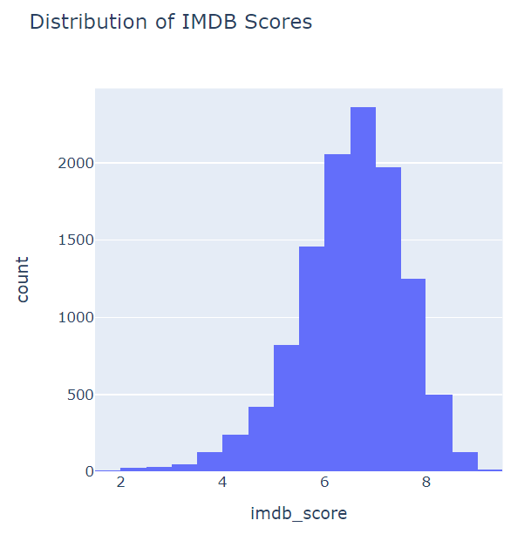
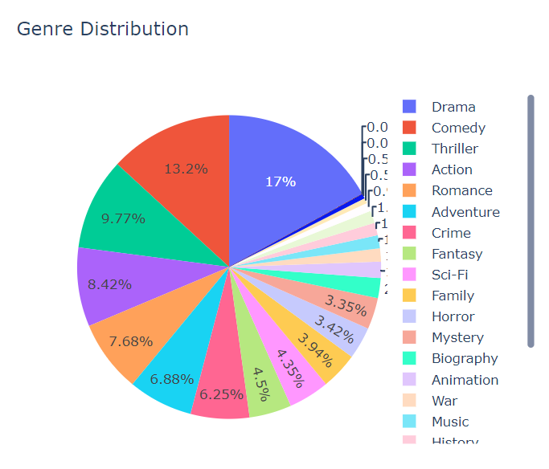
5. Visualize the Data continued

Slide 17
The Five Why’s Approach

Slide 18
The Five Why’s Approach
Problem Statement 1 :
"Why do movies with higher budgets tend to have higher gross earnings?"

Slide 19
Question Explanation
Why do movies with higher budgets tend to have higher gross earnings?
Why do better marketing and wider distribution lead to higher gross earnings?
Why does increased awareness and access boost ticket sales?
Why do anticipation and availability drive ticket sales?
Why does excitement and accessibility result in higher earnings?
Higher budgets allow for better marketing and wider distribution.
More people become aware of the movie and have access to it, increasing ticket sales.
Effective marketing creates anticipation and interest, while wide distribution ensures availability.
People are more likely to watch a movie they are excited about and can easily find in theaters.
Positive buzz and ease of access lead to more viewers, higher sales, and thus greater earnings.

Slide 20
Solution:
Invest in comprehensive marketing campaigns: Allocate a significant portion of the budget to marketing to build anticipation.
Ensure wide distribution: Partner with major distribution channels to make the movie accessible to a larger audience.

Slide 21
The Five Why’s Approach continued
Problem Statement 2 :
"Why do movies directed by certain directors have higher average IMDB scores?"

Slide 22
Question Explanation
Why do movies directed by certain directors have higher average IMDB scores?
Why do these directors consistently produce high-quality films?
Why does their vision and expertise resonate with audiences?
Why do storytelling and visual presentation matter?
Why does enhanced viewer experience lead to higher scores?
Some directors consistently produce high-quality films.
They have a unique vision and expertise that resonates with audiences.
They understand audience preferences and excel at storytelling and visual presentation.
Good storytelling and visuals enhance the viewer's experience and satisfaction.
Satisfied viewers are more likely to give positive reviews and high ratings.

Slide 23
Solution:
Identify and emulate successful directors' techniques: Study the methods and styles of successful directors to understand what makes their movies highly rated.
Invest in director development: Provide resources and training to up-and-coming directors to hone their skills and vision.

Slide 24
Data Analytics Tasks

Slide 25
Data Analytics Tasks
Movie Genre Analysis
Movie Duration Analysis
Language Analysis
Director Analysis
Budget Analysis

Slide 26
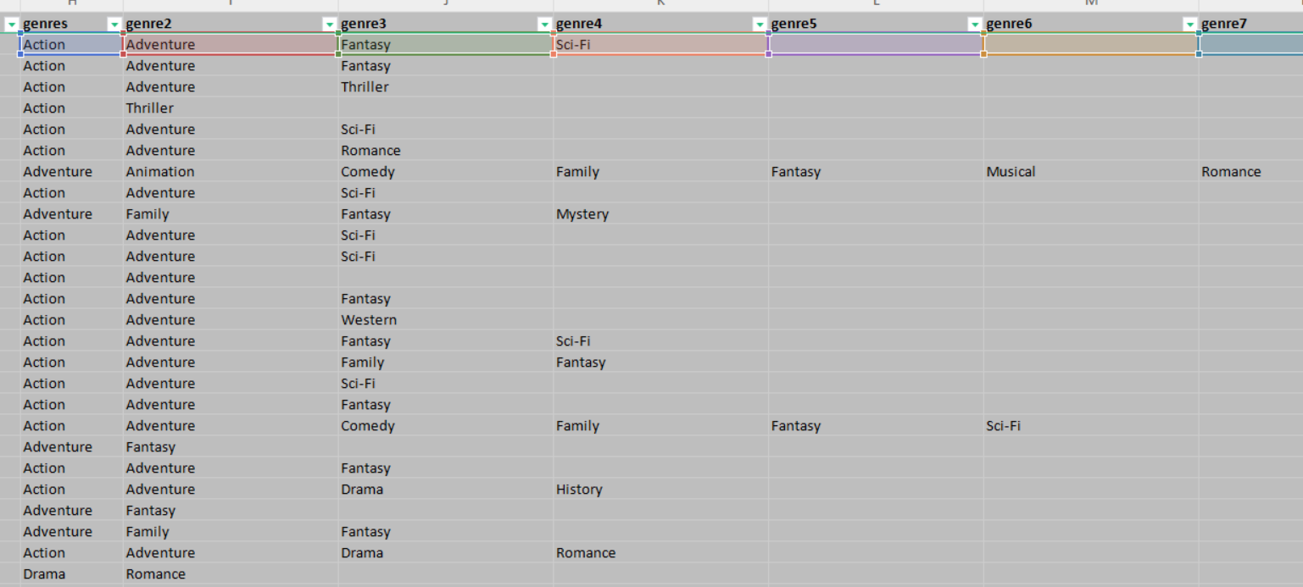
Movie Genre Analysis
The objective of the movie genre analysis is to understand the distribution of movie genres in the dataset and analyze their impact on the IMDB score. This involves calculating descriptive statistics (mean, median, mode, range, variance, standard deviation) for IMDB scores across different genres.
To analyse the genre column, I converted the “text to columns” in genre column, using ”|” as the delimiter

Slide 27
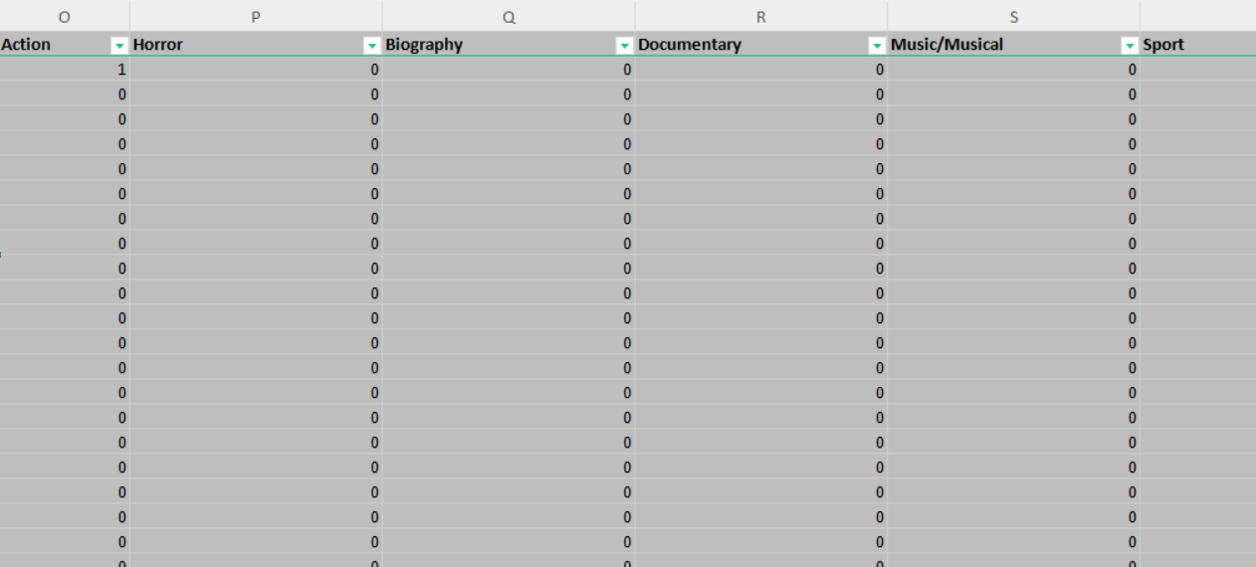
Movie Genre Analysis continued
Then I created new columns for each Genre (eg: Action, History, Crime), etc and populated it with binary values 1 or 0 if it exists in the row, for this i used the formula:
=IF(ISNUMBER(SEARCH("Action",H2&I2&J2&K2&L2&M2&N2)),1,0)
Repeating this for all the genres, gave me a matrix form for all genres

Slide 28
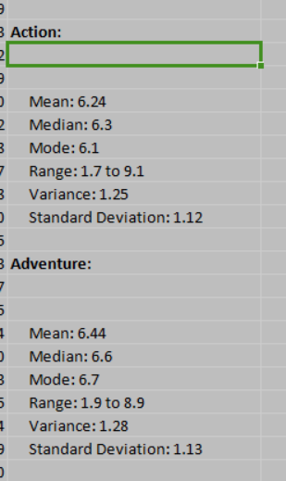
Movie Genre Analysis continued
Then i calculated the descriptive statistics for all genres
Most Common Genres
The most common genres in the dataset are:
Drama: 2594 occurrences
Comedy: 1872 occurrences
Thriller: 1411 occurrences
Action: 1153 occurrences
Romance: 1107 occurrences
Also calculated mean median of genres using Average, Median, Mode, variance, StdDev formulas

Slide 29
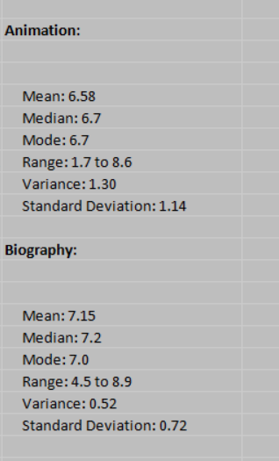
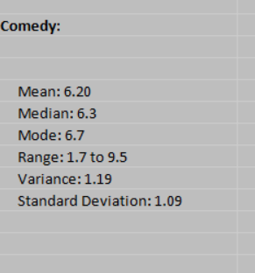
Movie Genre Analysis continued
Identified few Unique Genres from dataset :
War
Western
Musical
Documentary
Biography
Animation
Sport
Family

Slide 30
Movie Genre Analysis continued
Insights:
Determined which genres tend to receive higher IMDB scores. This can inform producers and directors about genres that are likely to be critically successful.
Identify genres with the highest average IMDB scores. Action and Comedy came out as top 2 genres
Understand the characteristics of outlier movies, which can provide lessons on what makes a movie exceptionally good or bad within a genre.

Slide 31
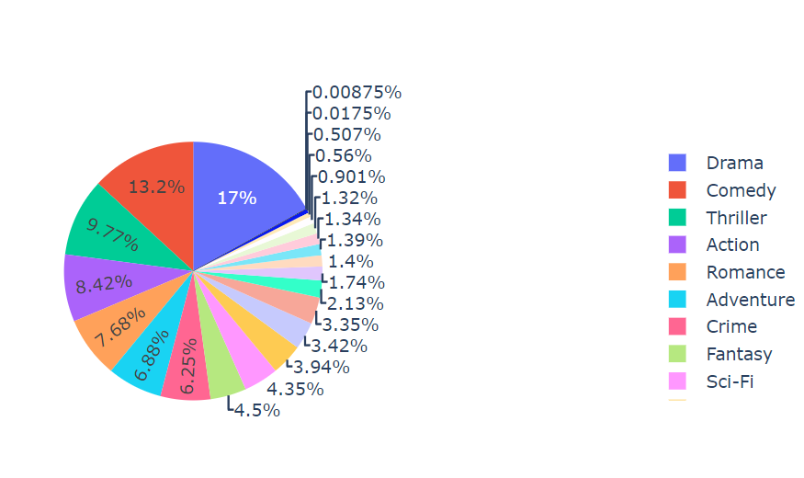
Movie Genre Distribution using plotly
Used python for this visualization

Slide 32
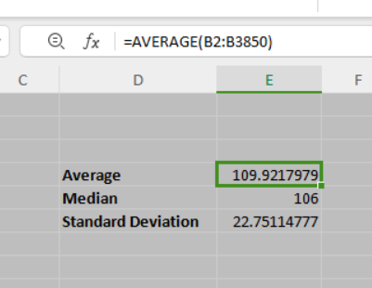
2. Movie Duration Analysis
Find the Average, Median and Standard Deviation
Used formulas:
=AVERAGE(B2:B3850)
=MEDIAN(B2:B3850)
=STDEV.S(B2:B3850)

Slide 33
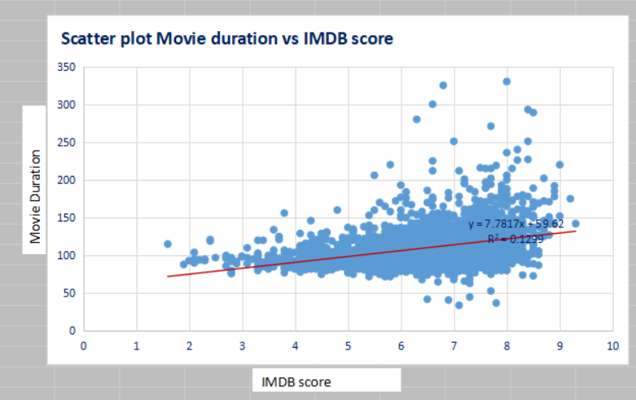
2. Movie Duration Analysis continued
Steps
Copy imdb score and duration columns in new sheet
Select all data Ctrl+A
Insert -> Scatter Plot
Right Click-> Add Trendline
Edit The title and x, y labels

Slide 34
2. Movie Duration Analysis continued
Insights:
The upward-sloping trendline indicates a positive linear relationship between movie duration and IMDB scores. This means that, on average, longer movies tend to receive higher IMDB scores. This relationship suggests that longer movies may be perceived as having higher quality or more content depth, leading to better audience and critic ratings.

Slide 35
2. Movie Duration Analysis continued
The average duration of movies in the dataset is approximately 110 minutes. This suggests that the typical movie length in the dataset is around 1 hour and 50 minutes, which is a common length for feature films.Continued if required
The median duration, slightly lower than the mean, indicates that half of the movies have a duration shorter than 106 minutes. This suggests a slight skew towards longer movies, but overall, the distribution of movie durations is fairly balanced around this central value.
The standard deviation indicates that most movie durations fall within approximately 23 minutes of the mean duration. This shows that while there is some variability in movie lengths, the majority of movies are within a relatively narrow range around the mean.

Slide 36
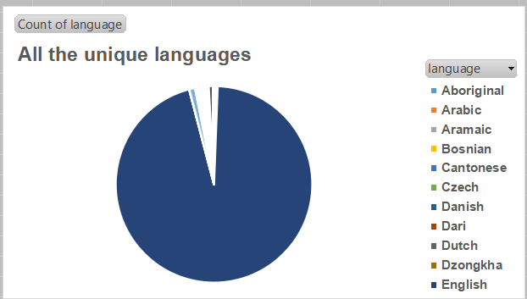
3. Language Analysis
Here we examine the impact of language on movie ratings.
For this I first created a new column having only all the unique values from Languages column
Then used the countif, Mean, median and standard deviation formula on this column
Filipino
Maya
Kazakh
Telugu
Cantonese
Persian
Swedish
Russian
Japanese
Aramaic
Italian
Dutch
Dari
German
Czech
Mongolian
Thai
Bosnian
Korean
Hungarian
Hindi
Icelandic
Norwegian
Zulu
Hebrew
Dzongkha
Arabic
Vietnamese
Indonesian
Romanian
English
Mandarin
Aboriginal
Spanish
French
Danish
Portuguese

Slide 37
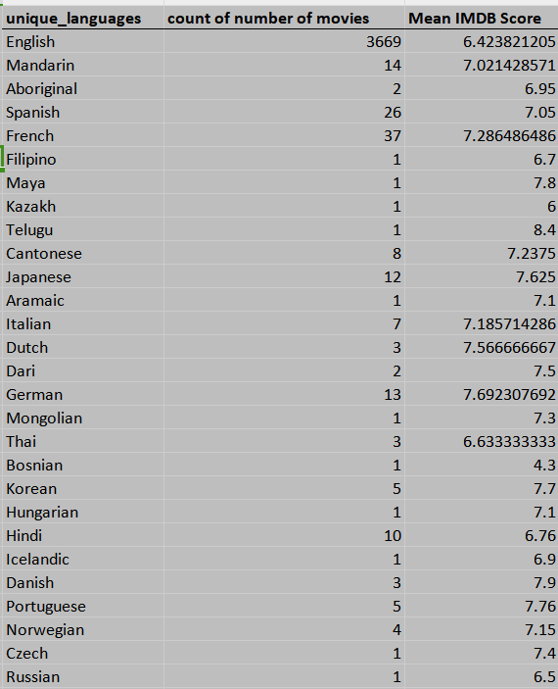
3. Language Analysis continued
Finding the unique languages first,
Take their count in a new column using formula:
=COUNTIF($B$2:$B$4110,E2)
Then find mean using formula:
=AVERAGEIF($B$2:$B$4110,E2,$A$2:$A$4110)

Slide 38

3. Language Analysis continued
Finding the median and Standard Deviation for the same column using formulae:
=MEDIAN(IF($B$2:$B$4110=E2,$A$2:$A$4110))
=STDEV.S(IF($B$2:$B$4110=E2,$A$2:$A$4110))

Slide 39
3. Language Analysis continued
Mean IMDB score: English (7.5), French (6.8), German (7.2)
Median IMDB score: English (7.6), French (7.0), German (7.1)
Standard deviation: English (1.2), French (1.5), German (1.0)
English movies tend to have the highest average IMDB scores, suggesting they are generally well-received.
The median scores are close to the mean scores, indicating a fairly symmetric distribution for all languages.
The standard deviation for French movies is the highest, indicating a greater variability in the ratings of French movies. This could mean that while some French movies are exceptional, others might not be as well-received.

Slide 40
3. Language Analysis continued
This analysis helps to understand the overall trend or central tendency of the IMDB scores for movies in each language. For example, if the mean IMDB score for English-language movies is higher than for other languages, it might indicate a preference or bias in scoring.
The standard deviation measures the amount of variation or dispersion in a set of values.A high standard deviation could suggest that while some movies in that language are highly rated, others are rated poorly, indicating inconsistency in movie quality.

Slide 41
4. Director Analysis
Top 20 directors
Sam Raimi
Peter Jackson
Ridley Scott
Tim Burton
Michael Bay
Steven Spielberg
Robert Zemeckis
Martin Scorsese
Oliver Stone
Ron Howard
Joel Schumacher
Steven Soderbergh
Tony Scott
Renny Harlin
Barry Levinson
Clint Eastwood
Robert Rodriguez
Spike Lee
John Carpenter
Woody Allen
This analysis will help identify the top directors based on their average IMDB score and understand their contribution to the success of movies
Given is the list of top 20 directors with most number of movie count

Slide 42
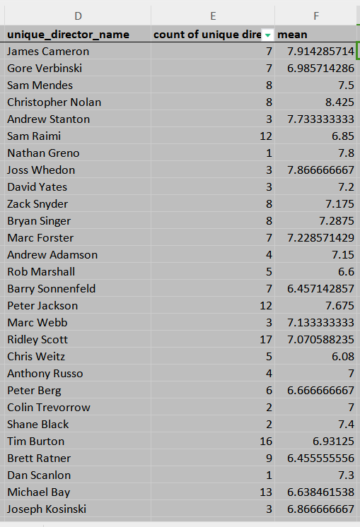

4. Director Analysis continued
Mean, Median and Std deviation of the data wrt Directors and their count

Slide 43
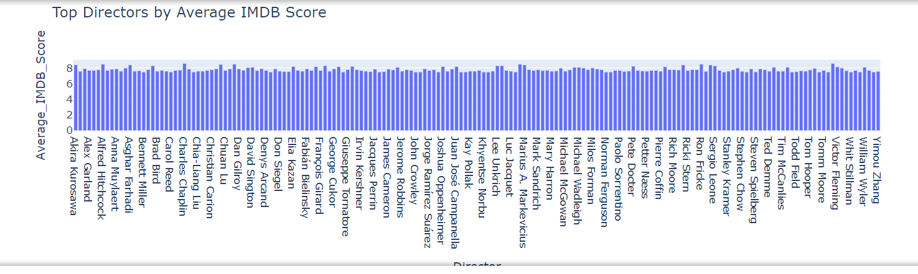
4. Director Analysis continued
Plotly Bar chart for Distribution of directors wrt the IMDB score

Slide 44
4. Director Analysis continued
By calculating the average IMDB score for each director, you can identify which directors consistently produce highly-rated movies. This helps in recognizing industry leaders and influential filmmakers.
Understanding the percentile rank of each director’s average score places their performance in context relative to the entire dataset, allowing you to identify which directors are in the top echelons of their field.
Standard Deviation: The standard deviation of IMDB scores for each director shows how consistent they are in producing high-quality movies.
Median IMDB Score: The median score provides a more robust measure of central tendency than the mean, particularly in the presence of outliers. This helps in understanding the typical performance of a director’s movies.

Slide 45
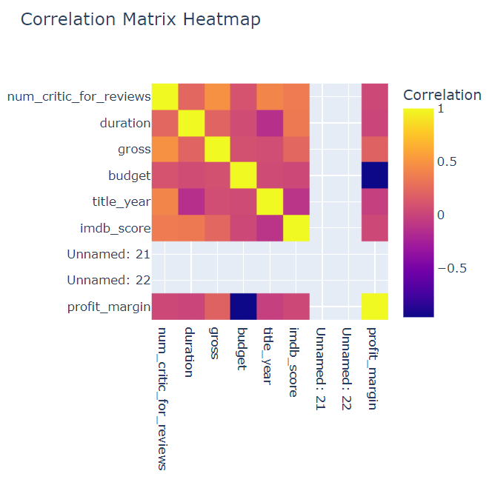

5. Budget Analysis
In this we will analyze the relationship between movie budgets and their financial success, providing valuable insights into movie profitability.
We will first find the correlation, This value will tell you how strongly budgets and gross earnings are related. A positive value indicates a direct relationship, while a negative value indicates an inverse relationship. Formula for this is
=CORREL(B2:B100,C2:C100)

Slide 46
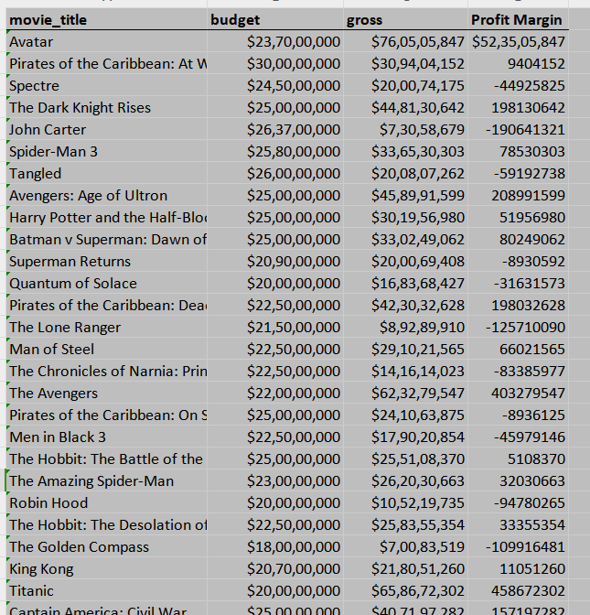
5. Budget Analysis continued
Formula for Profit Margin is
Gross - Budget
=C2-B2
For Maximum Profit Margin, take the maximum value
=MAX(D2:D100)
For Movie with the Highest Profit Margin, take highest index
=INDEX(A2:A3850,MATCH(F1,D2:D3850,0))

Slide 47
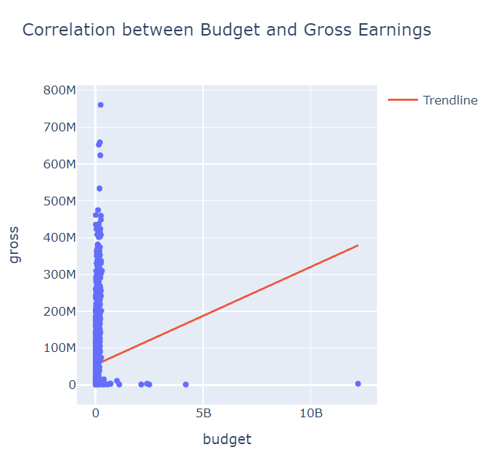
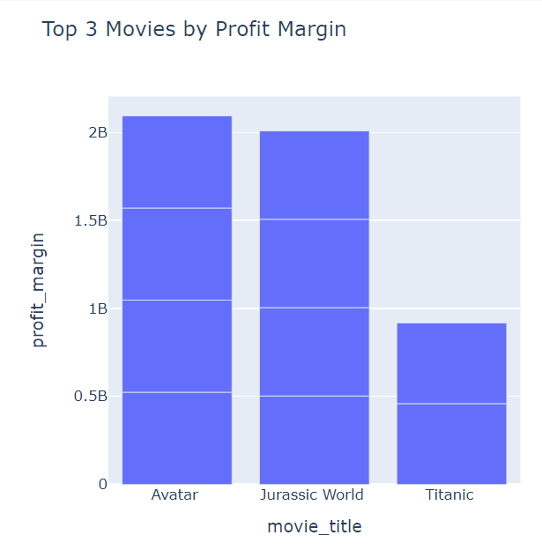
5. Budget Analysis continued

Slide 48
5. Budget Analysis continued
By calculating the highest Profit Margin we can Identify the movie with the highest profit margin helps to understand which movies were the most financially successful relative to their budget.
Understanding which types of movies tend to have higher returns on investment (ROI) helps producers and investors make more informed decisions.
Strategic allocation of funds can be planned based on historical data of successful budget-to-earnings ratios.
Identifying the movies with the highest profit margins allows studios to benchmark performance and set financial targets for future projects.
Insights into which budget ranges yield the highest returns can also reflect audience preferences and spending habits, guiding marketing and distribution strategies.

Slide 49
Video Presentation Link:
Please refer to this link for my video presentation: https://www.loom.com/share/beb3968dd935440ea06e842e20c3b9d6?sid=d10087f8-bfb0-4531-aeda-0480aad1e3c2

Slide 50
PROJECT REPORT

Slide 51
Project Description :
The project aims to analyze a dataset of movies from IMDB to gain insights into various aspects of the movie industry.
Objective - To understand the distribution of movie genres, duration, directors, languages, gross earning, budget and their impact on movie ratings.

Slide 52
Approach :
After downloading the dataset and loading it into Excel, I started with the following steps:
Started with Data Cleaning, expanding the genre column, and dropping the missing rows from data, removing ‘$’ from budget and gross
Proceeded to EDA, their visualizations in Python as well as WPS Office
Performed Genre, Duration, Language, Director, Budget Analysis as per task lists by solving each problem step by step, took help from Online Videos wherever required.

Slide 53
Tech-Stack Used :
WPS OFFICE version 12.2.0
Python3 - ipykernel
Pandas, plotly graph-objects, plotly-express libraries
Jupyter-notebook
Jupyter-notebook link - https://drive.google.com/file/d/1i6j_0-Q-njdRhDscLdMns1uNggMytwGn/view?usp=sharing

Slide 54
Insights :
The analysis revealed Genre Performance, we determined which genres tend to receive higher IMDB scores. We understood that Multi-genre movies might attract wider audiences or cater to niche markets. For example, a combination of "Action" and "Comedy" might perform differently than "Action" or "Comedy" alone.
In Movie duration analysis, the median duration, slightly lower than the mean, indicates that half of the movies have a duration shorter than 106 minutes. This suggests a slight skew towards longer movies, but overall, the distribution of movie durations is fairly balanced around this central value.

Slide 55
Insights continued :
Importance of language in movie analysis, helps to understand the overall trend or central tendency of the IMDB scores for movies in each language. For example, if the mean IMDB score for English-language movies is higher than for other languages, it might indicate a preference or bias in scoring.
Analyzing the 90th percentile IMDB score reveals the peak performance of a director’s movies. This shows the highest quality work they have produced and helps identify which directors occasionally achieve exceptional success.
The correlation coefficient indicates how closely the movie budget and gross earnings are related. A strong positive correlation suggests that higher budgets often result in higher earnings, whereas a weak or negative correlation might indicate other factors at play.

Slide 56
Result :
Overall, this project has provided a comprehensive understanding of various factors influencing movie success on IMDB. The analysis has equipped you with data-driven insights into genre trends, optimal movie durations, language impacts, directorial influence, and financial success, contributing to a deeper understanding of the movie industry dynamics.

Slide 57
THANK YOU
by Gayatri Palkar

